Slide 1
Intro to Node Servers
Lesson 6.1

Slide 2
A Moment of Caution

Slide 3

Node and Express servers and routing are two of the most important concepts in the entire program.

Slide 4

Forewarning: This Is the Challenging Stuff
The topics we’ll cover over the next three weeks will be challenging at times, but it’s also some of the most important material. This is when you’ll go from humble HTML/CSS hackers to employable full-stack engineers. Bring your A game!
Notes:
This image is public domain: https://en.wikipedia.org/wiki/Rosie_the_Riveter

Slide 5
Tips for Success
Form a study group. Get in the habit of explaining in-class exercises to one another, and work together on homework assignments.
Take notes! Jot down key concepts and ideas that come out of the in-class activities to help you keep things straight!
Ask “conceptual” questions. It’s important to understand the big picture, so if a key concept is confusing, be sure to ask about it!
Come to office hours. Seeking help during office hours will be increasingly valuable as the material becomes more complex. Come to these sessions and ask questions! We’re here to help you.

Slide 6

Be Confident!
Remember: If you’ve made it this far, you’ve proven that you have what it takes to succeed. Keep going!
Notes:
shutterstock_153860093

Slide 7
Remember Our Mantra:
When it comes to web development…

Slide 8
I know nothing.

Slide 9
You
Notes:
Seriously. Don’t lose sight of this image. At first it may feel intimidating, knowing how little you know. But relish the opportunity and take the privileges it comes with.
You have permission to struggle. To fail. To not “get” everything immediately.

Slide 10
So Let’s Begin

Slide 11

Remind Me Again
What is a server?
In modern web applications there is a constant back-and-forth communication between the visuals displayed on the user’s browser (frontend) and the data and logic stored on the server (backend).
Notes:
Image source: shutterstock_1051979417

Slide 12
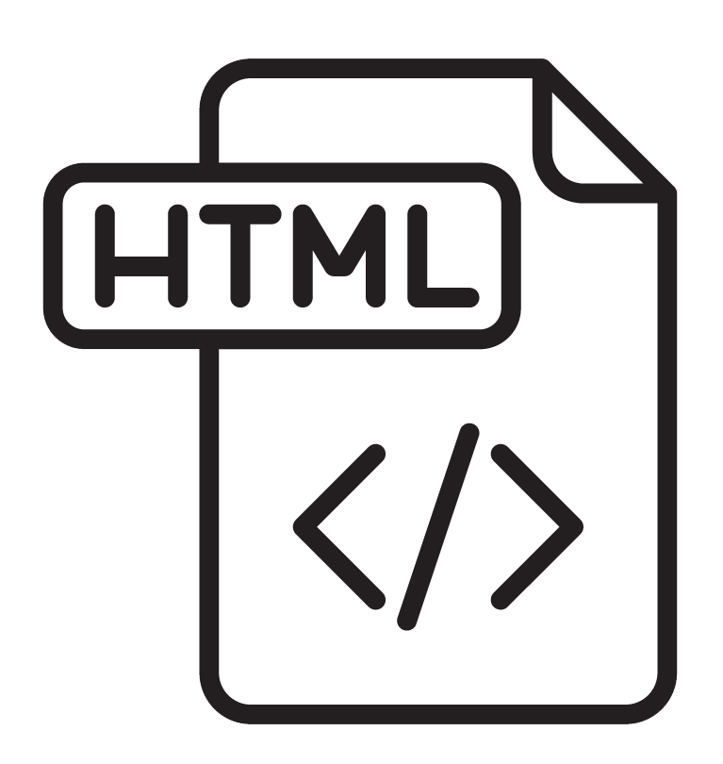

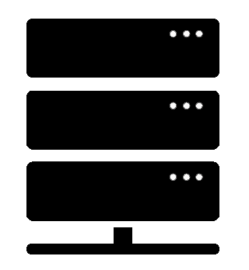
What Is a Server?
A server is the machine and code that handles client requests and responds to them.
The client's request contains the name and address
(the URL) of whatever the client is looking for.
Client Request
The server usually has a lot of content that it can send to clients. This content can be webpages, JPEGs, and other resources.
Server
Web Browser (Client)
Response
The server's response contains the actual
document that the client requested (or an
error code if the request cannot be processed).
Intro to Node Servers

Slide 13
Remind Me Again
What are some examples of server-side functions?
In modern web applications there is a constant back-and-forth communication between the visuals displayed on the user’s browser (frontend) and the data and logic stored on the server (backend).
Notes:
Image source: shutterstock_1051979417

Slide 14
Server-Side Code in Action!
Visiting a URL and then being presented with an HTML page
Visiting an API endpoint that parses URL parameters to provide selective JSONs
Clicking an invoice that provides a PDF report
Image-processing software that applies a filter to an image and saves the new version
Google providing results relevant to searches on other sites

Slide 15
Remind Me Again
What is a client?
In modern web applications there is a constant back-and-forth communication between the visuals displayed on the user’s browser (frontend) and the data and logic stored on the server (backend).
Notes:
Image source: shutterstock_1051979417

Slide 16
What Is a Client?
A client is a user’s personal machine which makes “requests” of the server.
The client's request contains the name and address
(the URL) of whatever the client is looking for.
The server usually has a lot of content that it can send to clients. This content can be webpages, JPEGs, and other resources.
Client Request
Server
Web Browser (Client)
Response
The server's response contains the
document that the client requested (or an
error code if the request cannot be processed).

Slide 17
Remind Me Again
How do the client and server communicate with each other?
In modern web applications there is a constant back-and-forth communication between the visuals displayed on the user’s browser (frontend) and the data and logic stored on the server (backend).
Notes:
Image source: shutterstock_1051979417

Slide 18
HTTP/HTTPS
Clients and servers communicate with each other using a series of requests and responses defined by HTTP / HTTPS (Hypertext Transfer Protocol Secure).
The client's request contains the name and address
(the URL) of whatever the client is looking for.
The server usually has a lot of content that it can send to clients. This content can be webpages, JPEGs, and other resources.
Client Request
Server
Web Browser (Client)
Response
The server's response contains the
document that the client requested (or an
error code if the request could not be processed).

Slide 19



Full-Stack Development
In modern web applications, there is constant back-and-forth communication between the visuals displayed on the user’s browser (front-end) and the data and logic stored on the server (back-end).
Client Browser (Front-End)
React.js
HTML/CSS/Image Assets
JavaScript (Client Side)
JSON/XML
User Interactions
Server (Back-End)
Node.js
Express Web Server
Server-Side Scripts and Services | Raw Files
MongoDB
Database
USER
Request
Response

Slide 20
Full-Stack Development
You can think of the server and the client as two distinct “machines.”
Client Browser (Front-End)
React.js
HTML/CSS/Image Assets
JavaScript (Client Side)
JSON/XML
User Interactions
Server (Back-End)
Node.js
Express Web Server
Server-Side Scripts and Services | Raw Files
MongoDB
Database
USER
Request
Response

Slide 21
Deep Dive into Servers

Slide 22

Visualizing Servers
Server hardware looks like large, ruggedized versions of desktop computers.
Notes:
shutterstock_300344546.

Slide 23
Visualizing Servers
These machines and their code handle all requests coming in from the browsers accessing a website.
Web Browser (Client)
Web Browser (Client)
Web Browser (Client)
Server
Web Browser (Client)
Web Browser (Client)
Web Browser (Client)
Web Browser (Client)
Web Browser (Client)

Slide 24

Visualizing Servers
Where does the server live?
Notes:
shutterstock_622449173

Slide 25


Where Do Servers Live?
Servers live in dedicated hardware intended to handle the requests and responses from many clients.
Servers most often live on cloud platforms like AWS, Heroku, and Google Cloud.

Slide 26

Servers During Development
During development, our personal computers will simulate both the client and the server.
We will create a local server (Localhost) on our computer and then use our browser to interact with it.
Localhost
Personal Computer
Browser

Slide 27
Building a Server

Slide 28
Building a Server
For our purposes, “building a server” means writing code that handles what the server will do.
It’s important to note that even though you pay for server-side hardware, you still need to write the code that goes inside.
This code enables functions such as:
Establishing connections to the database
Authenticating user requests
Handling client-side URL requests
Logging client requests
Performing server-side processes

Slide 29
Your Server: A Big Box
Throughout this week, imagine your server as a big, empty box.
Server
We will add code snippets and modules to give our big, empty box the power to do stuff in response to all the requests that come in.

Slide 30
Inside the Box: Connections
How do we allow the client to connect to the server?
We’ll add a listener to the server that allows it to listen for client requests.
Server
Listen

Slide 31
Inside the Box: Parsing
We give the server the ability to parse, or interpret, URLs that the user requests.
Server
Listen | URL Parse

Slide 32
Inside the Box: Routing
Then, based on a URL’s keywords, the server will be able to route, or direct, the flow of logic to initiate other processes.
Server
Listen | URL Parse
Route Handling

Slide 33
Inside the Box: Sending Files
These “other processes” might be sending an HTML file to be rendered or sending a JSON file to be rendered.
Server
Listen | URL Parse
Route Handling
Send HTML | Send JSON

Slide 34
Inside the Box: Receiving Posts
We can also include a module to handle receiving a user’s POST requests—the data they send the server.
Server
Listen | URL Parse
Route Handling
Send HTML | Send JSON
Receive POSTs

Slide 35
Inside the Box: Performing Logic
We can also have complex server-side logic that will initiate in response to users visiting a route endpoint or sending us data.
Server
Listen | URL Parse
Route Handling
Send HTML | Send JSON
Receive POSTs | Server-Side Logic

Slide 36
Inside the Box: And More!
But it doesn’t stop there!
Server
Listen | URL Parse
Route Handling
Send HTML | Send JSON
Receive POSTs | Server Side Logic
And More!
We can add functionality for authentication, logging requests, connecting to databases, and so much more.
Always remember that we’re coding out these functionalities into our box!

Slide 37
Questions?

Slide 39
Express Yourself

Slide 40
Early Concerns

Slide 41


Comment #1
This is all so confusing.
Notes:
shutterstock_1188695488

Slide 42

Comment #1: “This is all so confusing.”
Response: And it will be for your employer as well.
Notes:
shutterstock_112957384

Slide 43
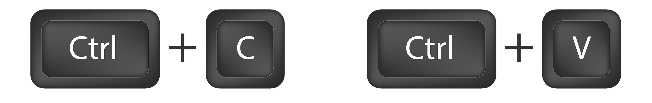
Comment #2
I feel like I’m just copying and pasting.
Notes:
Image source: shutterstock_318828878

Slide 44
Comment #2: “I feel like I’m just copying and pasting.”
Response:
Back-end code libraries mean you have to code less.
Often you are just copying and pasting “best practices” over and over again.
Notes:
Image source: shutterstock_318828878

Slide 45
Express

Slide 46
Remind Me Again
What is Express?
In modern web applications there is a constant back-and-forth communication between the visuals displayed on the user’s browser (frontend) and the data and logic stored on the server (backend).
Notes:
Image source: shutterstock_1051979417

Slide 47
Express.JS
Express is a web framework for Node that makes creating server-side code much simpler.

Slide 48
Remind Me Again
What is a route?
In modern web applications there is a constant back-and-forth communication between the visuals displayed on the user’s browser (frontend) and the data and logic stored on the server (backend).
Notes:
Image source: shutterstock_1051979417

Slide 49

Routes = Maps
Notes:
shutterstock_461093119

Slide 50

Routes = Maps
User visits a link…
/
Server
User is shown the “Home” Page
/saved
User is shown the “Saved” Page
/api/headlines
User is given JSON containing all of the headline data.
Notes:
Trilogy created diagram does not violate copyright

Slide 51
Quick Example
nyt-mongo-scraper.herokuapp.com

Slide 52
Client-Server Communication (GET)
1
User visits “/” route
GET Request
Client Browser Home Page
Node Server
Notes:
Trilogy created diagram does not violate copyright

Slide 53
Client-Server Communication (GET)
1
User visits "/saved" route
2
GET Request
Request triggers the code in the server route. The server then finds the relevant HTML content and data.
Client Browser Saved Articles
Node Server
3
Server responds by providing HTML with saved articles.
Notes:
Trilogy created diagram does not violate copyright

Slide 54
Client-Server Communication (POST)
1
User saves an article using ”api/headlines”.
POST Request
Client Browser Clicks on Save Article button
Node Server
Notes:
Trilogy created diagram does not violate copyright

Slide 55
Client-Server Communication (POST)
1
User saves an article using ”api/headlines”.
2
POST Request
Request triggers the code in the server route. The server then sets the article as “saved” in the database.
Client Browser Clicks on Save Article button
Node Server
3
“Saved” articles are loaded on the saved page.
Notes:
Trilogy created diagram does not violate copyright

